Slide 1
SUDOKU RESOLUTION VIA CSP

Slide 2
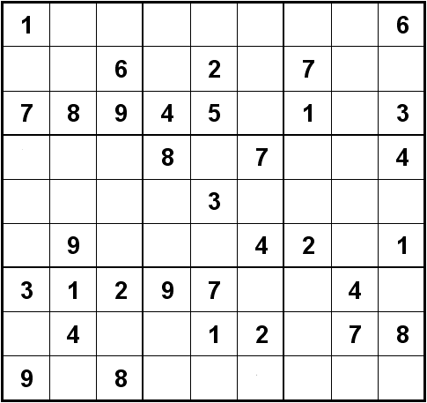
Introduction to the project's subject
Solving a Constraint Satisfaction Problem (CSP), with a focus on applications, in our case Sudoku solving.

Slide 3
Goal and Motivation
Goal:
Develop a program using an efficient algorithm to solve CSPs.
Motivation:
Automate solving problems.
Demonstrate how algorithms like backtracking and state-space search work.
Apply these methods to practical examples, like logic games and optimization tasks, Sudoku in our case.

Slide 4
BACK TO BASICS

Slide 5
What is a CSP?
CSP (Constraint Satisfaction Problem) breaks the problem into three components:
Variables: elements we want to assign
Domains: the possible values we can assign to a variable
Constraints: the set of rules which decide which values are valid and which not
GOAL: assign a value to each variable such as none of the constraints are broken
Example: we want to assign each rectangle a color (blue, red or green), but two rectangles of the same color cannot be adjacent to each other:
X₁
X₃
Variables: X₁, X₂, X₃, X₄, X₅
Domains: Blue, Green, Red
Constraint: X_{i} ≠ X_{j} if X_{i} and X_{j} are adjacent
X₂
X₄
X₅

Slide 6
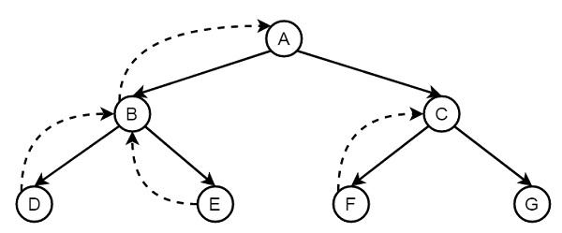
Potentially useful methods / algorithms
All our research lead to the potential use of the following algorithms:
Backtracking
Forwarding checking
The articles explain constraint satisfaction problems CSP and how algorithms like backtracking or forward checking are essential for efficiently solving complex combinatorial tasks, including puzzles like Sudoku.
X₁
X₃
X₂
X₄
X₅

Slide 7
Literature Review
[1] S. C. Brailsford, C. N. Potts, and B. M. Smith, “Constraint satisfaction problems: Algorithms and applications,” European Journal of Operational Research, vol. 119, no. 3, pp. 557–581, Dec. 1999, doi: 10.1016/S0377-2217(98)00364-6.
[2] “berggren_patrik_OCH_nilsson_david_K12011.pdf.” Accessed: Oct. 27, 2024. [Online]. Available: https://www.csc.kth.se/utbildning/kandidatexjobb/datateknik/2012/rapport/berggren_patrik_ OCH_nilsson_david_K12011.pdf
[3] P. R. Kude, “Formulation of CSP Problem : Sudoku puzzle,” Medium. Accessed: Oct. 30, 2024. [Online]. Available: https://medium.com/@co.2020.prkude/formulation-of-csp-problem-sudoku-puzzle-7d5e1d54738 2https://www.csc.kth.se/utbildning/kandidatexjobb/datateknik/2012/rapport/berggren_patrik_OC H_nilsson_david_K12011.pdf
[4] T. Simonis, "Sudoku as a Constraint Problem," presented at the 2005 International Workshop on Modeling and Reformulating Constraint Satisfaction Problems (CP 2005), Sitges, Spain, Oct. 2005. [Online]. Available: https://ai.dmi.unibas.ch/_files/teaching/fs21/ai/material/ai26-simonis-cp2005ws.pdf
[5]J. J. Schneider and S. Kirkpatrick, "The Constraint Satisfaction Problem," in Stochastic Optimization, Springer, 2006. [Online]. Available: https://doi.org/10.1007/978-3-540-34560-2_46
[6]D. E. Smith, M. M. MacGregor, and S. M. Smith, "Robust Constraint Satisfaction Problems," in Proceedings of the Fifth International Conference on Information Technology: New Generations, Las Vegas, NV, USA, 2005, pp. 383-389. [Online]. Available: https://citeseerx.ist.psu.edu/document?repid=rep1&type=pdf&doi=fc78d54ae5d5234c9fb229d6a 2cd2ef5af181e70

Slide 8
Literature Review
[1] The article explains constraint satisfaction problems CSP and how algorithms like backtracking or forward checking are essential for efficiently solving complex combinatorial tasks, including puzzles like Sudoku. These methods involve assigning values to variables while satisfying all given constraints, which coincides with solving sudokus through state space search. Specifically, forward checking and backtracking are highlighted as techniques that prune the search space, similar to our project’s goal of optimizing Sudoku solutions through CSP approaches
[2] Our sudoku solver uses a backtracking algorithm. This means it tries different numbers in each empty square, and if it finds a conflict (like two of the same number in a row), it goes back and tries a different number. To make it faster, we use a technique called forward checking, which helps us spot problems early. We also prioritize filling squares with the fewest possible choices. This way, we can solve the puzzle more quickly. This approach is explained in the following article page 15.
[3] The webpage provides an overview of sudoku mechanics and demonstrates how CSP techniques can be applied to solve such puzzles. It thoroughly explains the CSP formulation, detailing the variables, domains, and constraints involved. Additionally, it includes a Python code snippet that shows this approach in action.
[4] This paper by Tobias Simonis explores different solutions of Sudoku puzzles using constraint programming techniques. The author details how the structure of Sudoku can be modeled as a CSP and demonstrates how this approach systematically eliminates possible values to reach a solution. The work also includes discussions on efficiency and general CSP applications.
[5]This chapter shows an overview of the constraint satisfaction problem (CSP), including its formal definition and the different ways for representing and reasoning about such problems. The authors discuss various techniques applicable to CSPs. The chapter also includes pseudocode for key algorithms, which is a vital resource for understanding CSPs in optimization contexts.
[6]This article discusses the concept of RCSPs (Robust Constraint Satisfaction Problems), which amplifies traditional CSPs by incorporating robustness against uncertainty in problem parameters. Smith and MacGregor search for various approaches to the solution of RCSPs, including their application in real-world scenarios where data could be incomplete.

Slide 9
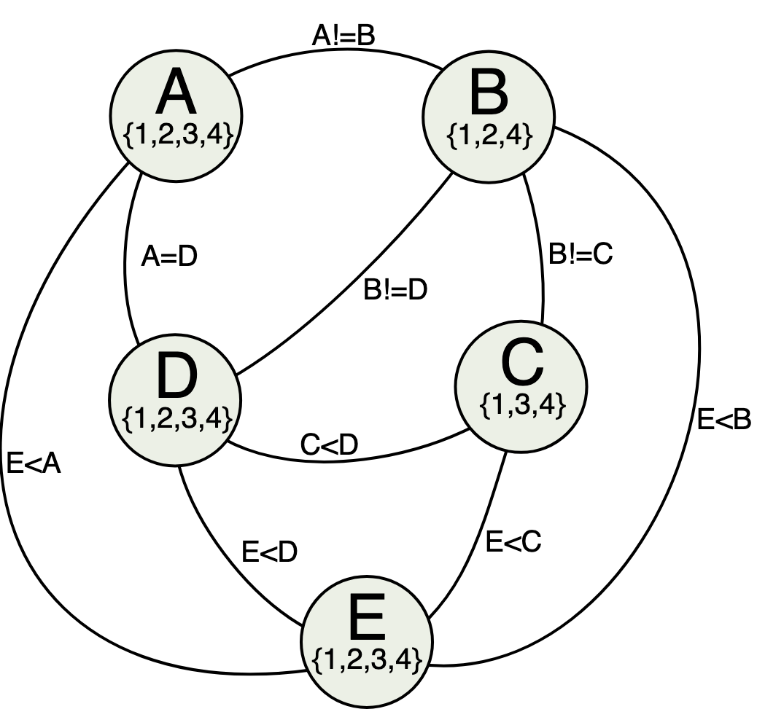
The used approach
Finally, the used approach include using the following algorithms:
Backtracking
Forward checking
AC-3
We included the AC-3 algorithm
as later explained, it is really useful.

Slide 10
Summary of the methods

Slide 11
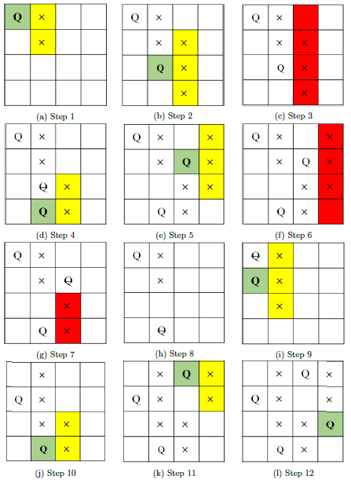
AC-3
AC3 is an algorithm used to reduce the domains of variables in a CSP, ensuring the arcs between variables are consistent.
An arc is a directional relationship between two variables in a CSP, typically defined by a constraint.
In Sudoku:
If X and Y are two variables representing cells in the same row, the constraint is that X≠Y (no two cells in the same row can have the same value).
The AC3 algorithm systematically checks and updates the domains of all variable pairs (arcs) to ensure consistency:
It removes values from a variable's domain if they cannot be matched
If a value is removed, it may affect other arcs involving the modified variable, so those arcs are rechecked.

Slide 12
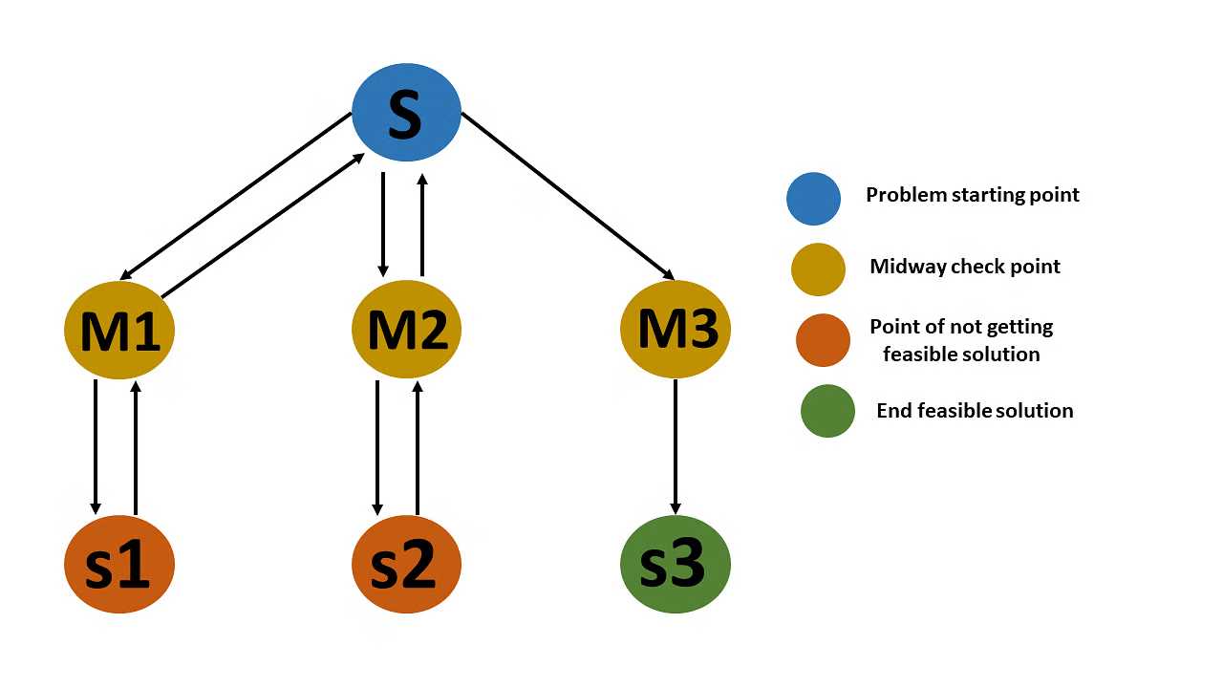
Backtracking with Forward Checking
Used to solve the CSP by assigning values to variables step-by-step while respecting constraints.
Backtracking is a systematic way of trying out possible solutions, moving forward when constraints are satisfied and stepping back when a conflict occurs.
Forward checking enhances this process by proactively pruning values from the domains of future variables whenever a variable is assigned a value, reducing unnecessary computations.

Slide 13
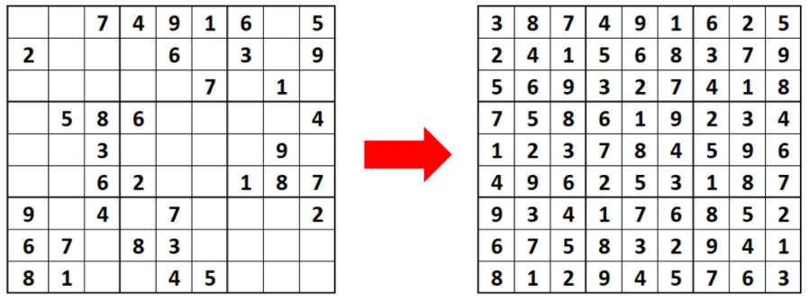
STEPS:
Read test sudokus
Use AC3
Backtracking with forward checking
Write completed sudoku on a file
Write the average time and the total time for all sudokus completed

Slide 14
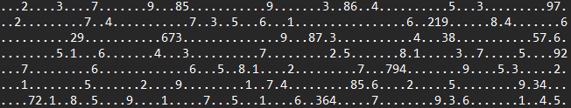
Sudoku’s treatment
Our Test Sudokus are provided in text files, formatted as a single string of characters. Each string represents the puzzle's 81 squares in sequence, with empty squares represented by dots (.) and filled squares showing numbers from 1 to 9.
Seven Sudokus

Slide 15
Recollection of data
For each test sudoku read from the file, we collect some key data, enabling it to solve the puzzle using a constraint satisfaction problem (CSP) approach. We will use some Data Structures:
-Variables : Each square of the 9x9 array which represents the sudoku grid will be one Variable object, representing a position (row and column) on the board with a certain domain. We will have 81 variables in total corresponding to each grid.
-Constraints: Each puzzle has constraints for correct solving. Constraints are created whenever a cell already has a number (i.e., not a dot .). These constraints ensure that the cell maintains its given value. To solve this problem, we will use “equal to” and “all disjoint”
-Assignments: This list records the assignments made to each variable in the grid as the puzzle is solved. It includes the initial setup and the solution steps.

Slide 16
Explanation of the code

Slide 17
Data types
ConsitencyArc.java
Creating representations of arcs.
The class ensures that a relationship (arc) between two variables (varDistinguished and varNotDistinguished) is arc-consistent based on their domain.
Specifically, it checks and adjusts the domain of varDistinguished based on the value of varNotDistinguished.
Variable.java
Stores Possible Cell Values (domain)
Identifies the Row, Column and initialize 3x3 Subgrid
asig.java
Manages assignments of values to variables.
Initializes default value to -1
sudokuStatejava
Manages the state of the Sudoku grid, tracks constraints, and performs operations like forward checking (or reverse forward checking) and domain prioritization.

Slide 18
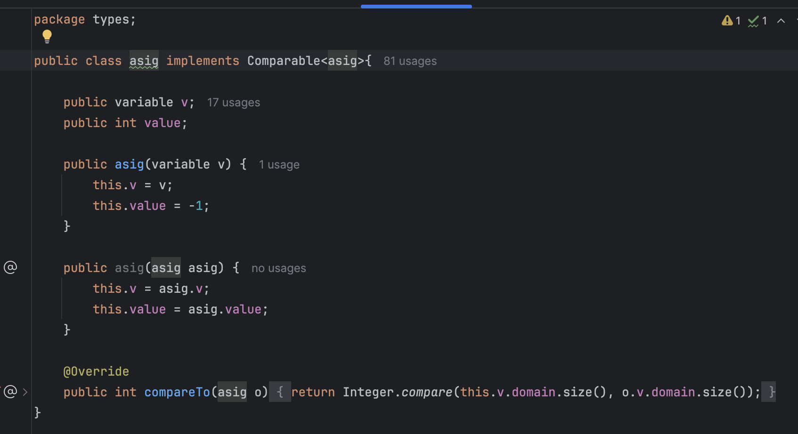
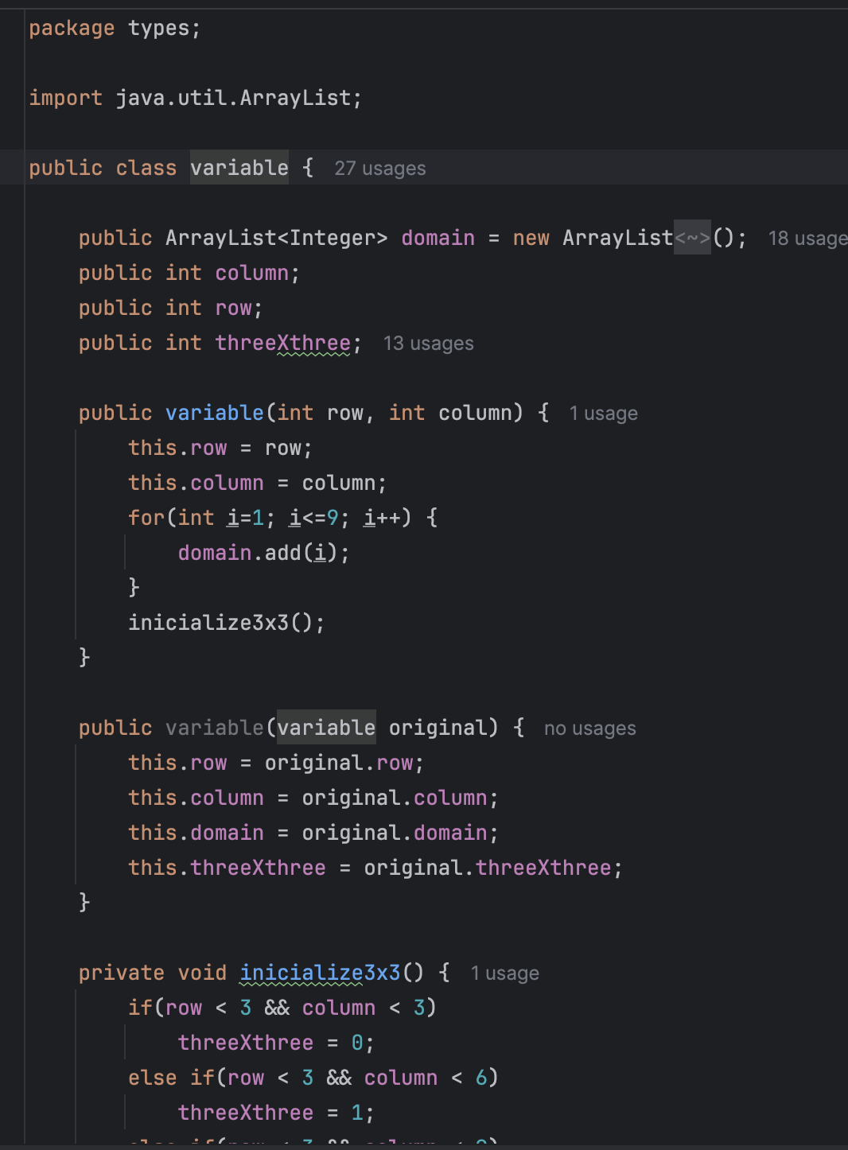
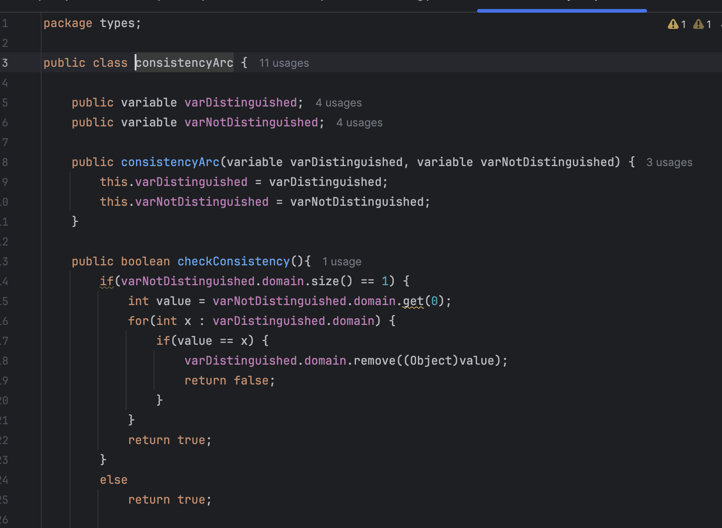
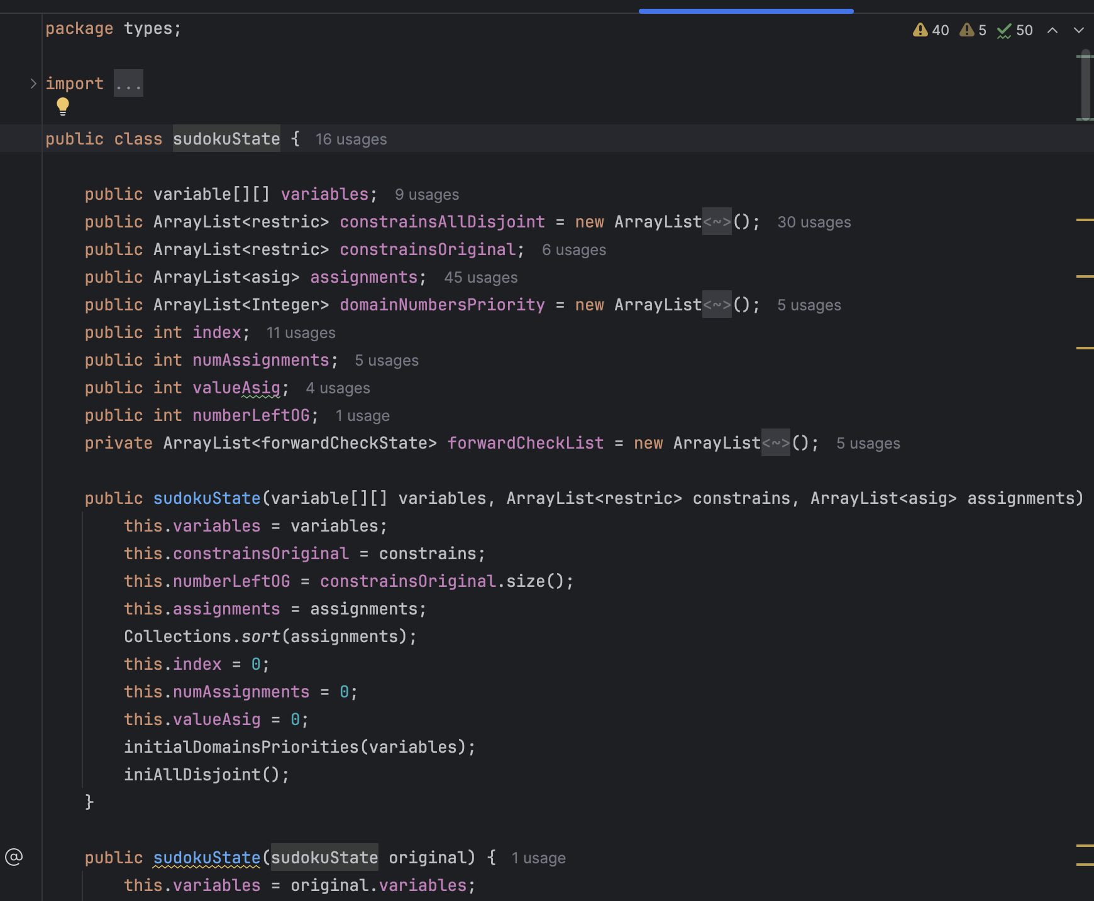
Types
Asig.java
Variable.java
ConsitencyArc.java
sudokuState.java

Slide 19
Algorithms
ac3.java
implements the AC-3 (Arc Consistency 3) algorithm.
It reduce the domains of variables by ensuring arc consistency.
The class identifies all relationships (arcs) between variables and checks them for consistency.
The algorithm iterates through all arcs and ensures that for every variable, there exists a value in its domain that satisfies the constraints with connected variables.
Inconsistent arcs trigger domain reductions and further checks.
search.java
Implements a backtracking search with forward checking algorithm:
Implements backtracking to explore variable assignments systematically.
Uses forward checking to reduce the domains of unassigned variables, avoiding unnecessary computation.
Incorporates two types of constraints:
Equality Constraint (equal_to): Ensures variables are assigned specific values.
All Disjoint Constraint (alldisjoint): Ensures uniqueness of values within rows, columns, or blocks.

Slide 20
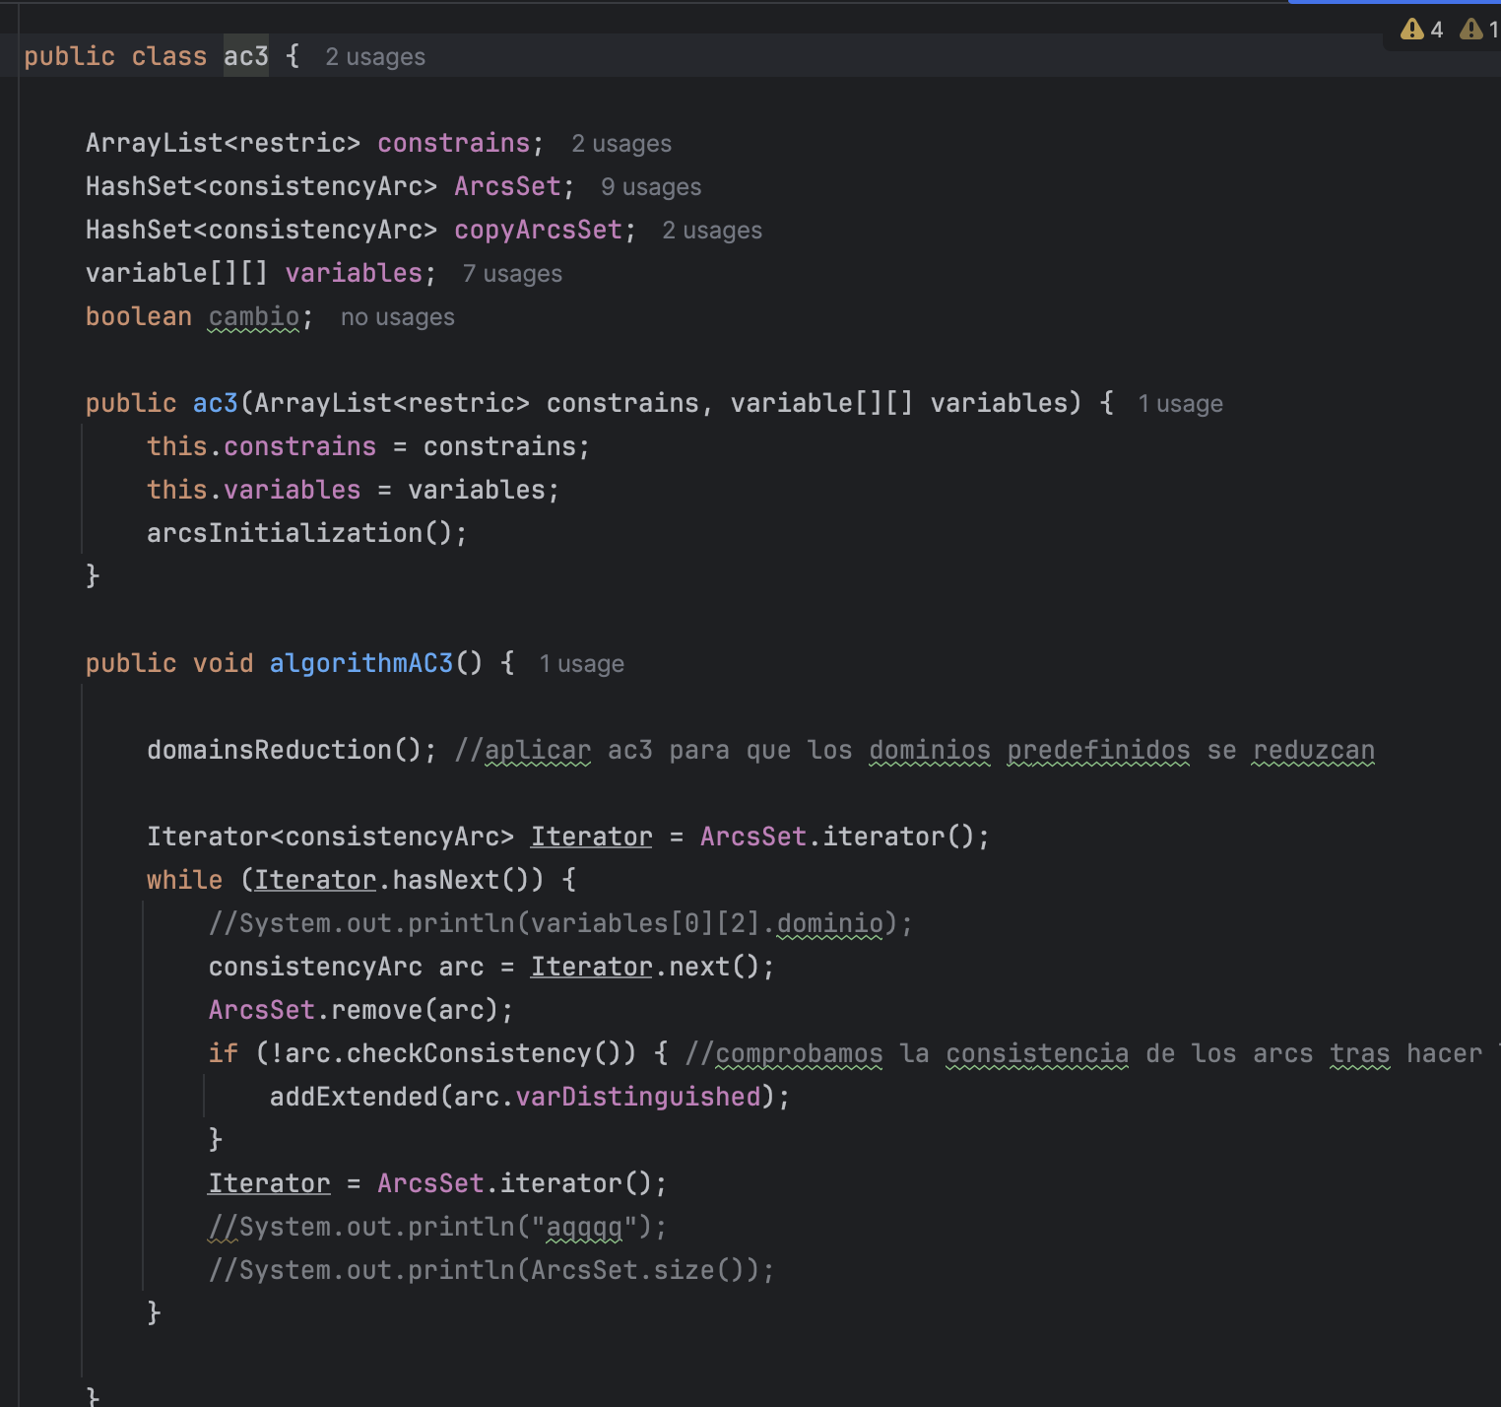
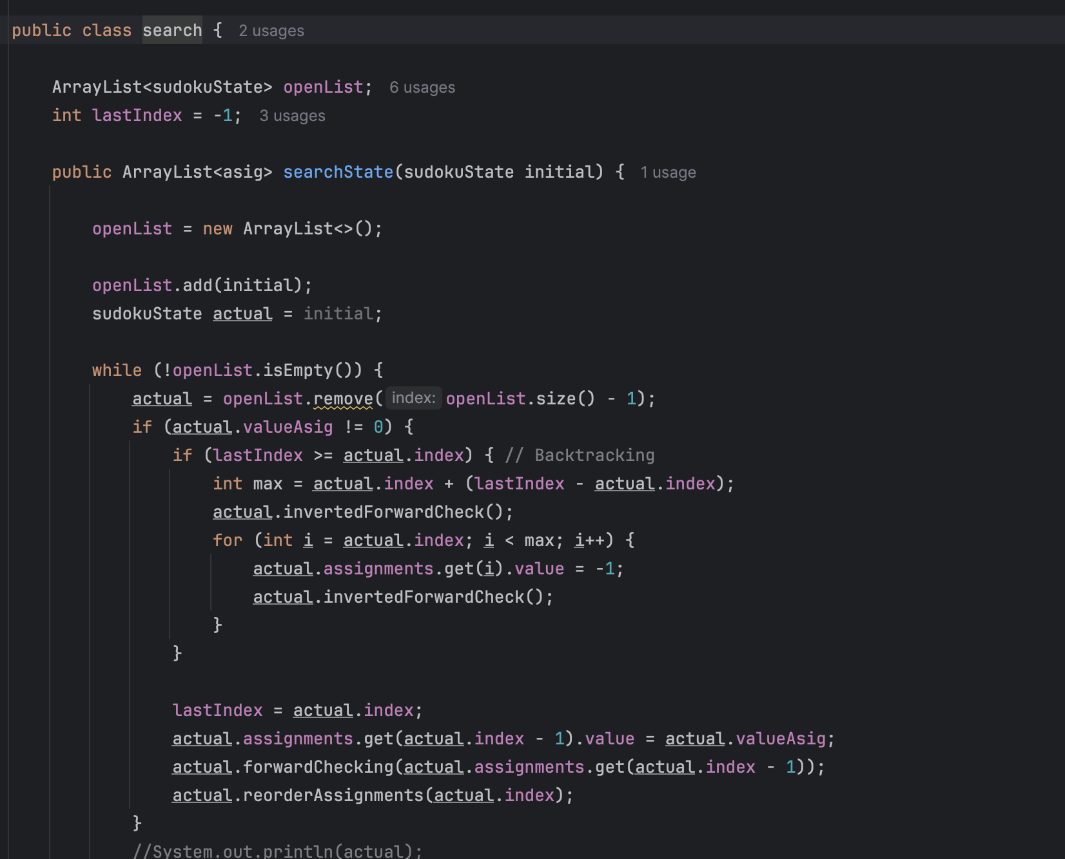
Algorithms
ac3.java
search.java

Slide 21
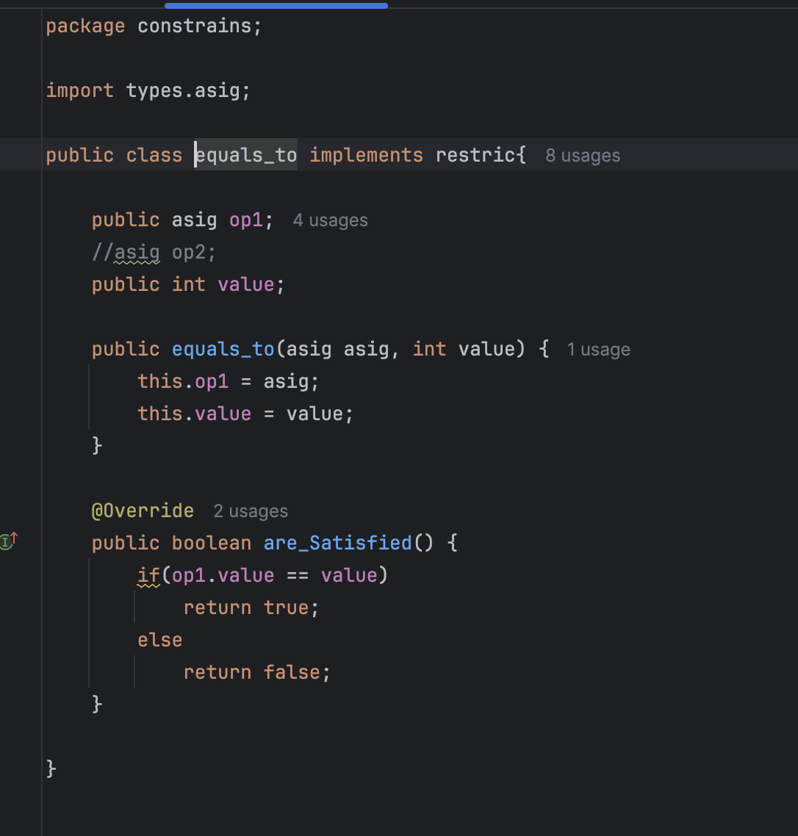
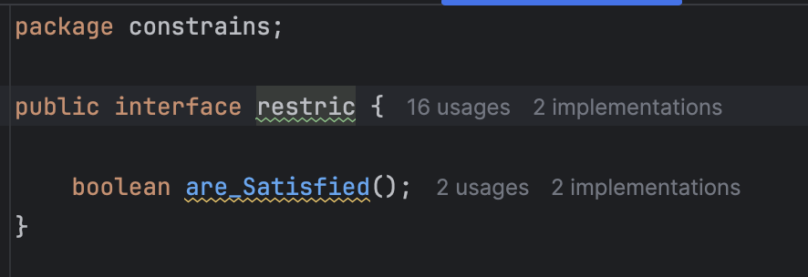
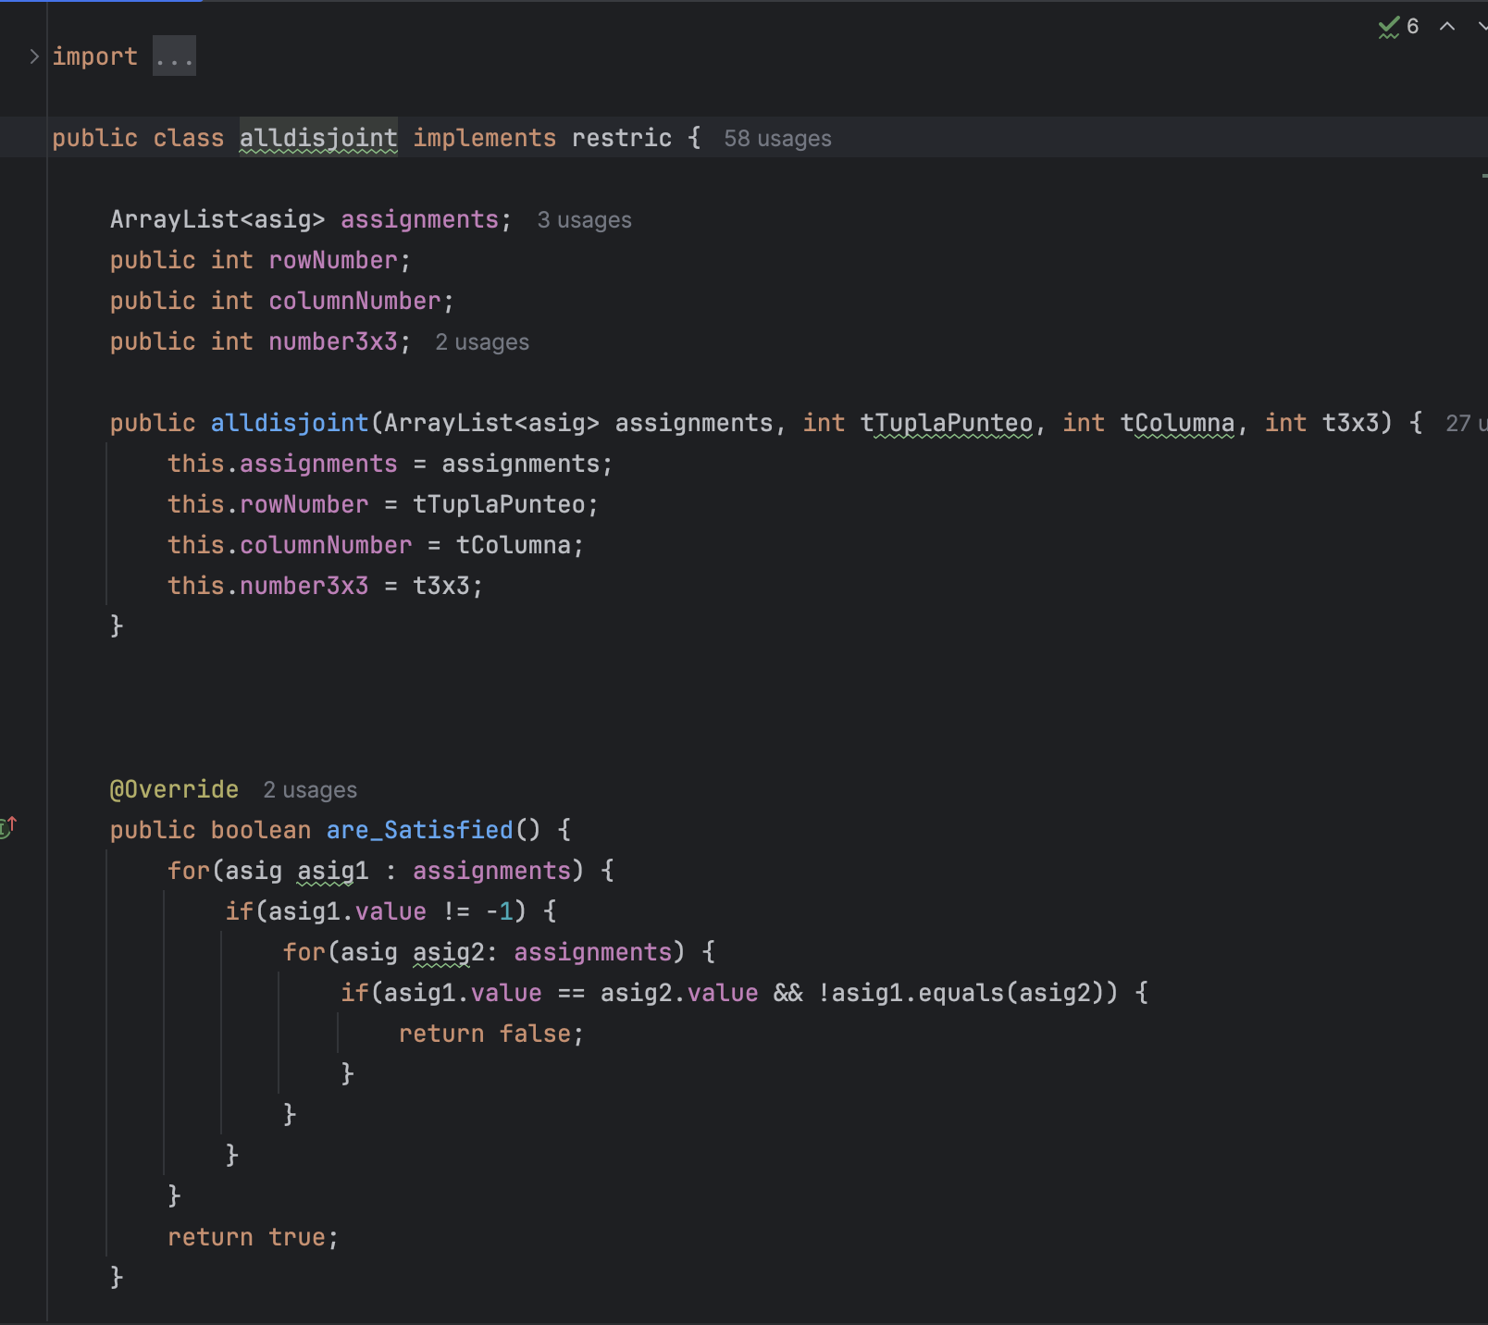
Restrictions
alldisjoint.java
Implements a restric interface, and ensures that a group of assignments (asig) follows the "all disjoint" constraint
equals_to.java
Implements a constraint that enforces a variable to be equal to a specific value.
restric.java
Interface which implements if the constraint is satisfied

Slide 22
Files
Lecturefiles.java
Opens the file and initializes a Scanner to read its contents line by line.
For each line (puzzle) in the file, resets the restrictions and assignments lists.
Iterating through each cell, creates a new variable, with his row and column number.
For non-empty cells (not .), adds an equal_to constraint to the restrictions list, enforcing that cell's value.
Uses the AC-3 algorithm to prune the domains of variables, reducing the search space
Initializes the search class and creates an initial (state_S) with the current grid, constraints, and assignments.
Solves the puzzle using the search method.
Writes the solution to the output file.
Tracks execution time for each puzzle and calculates the total and average solving time across all puzzles.

Slide 23
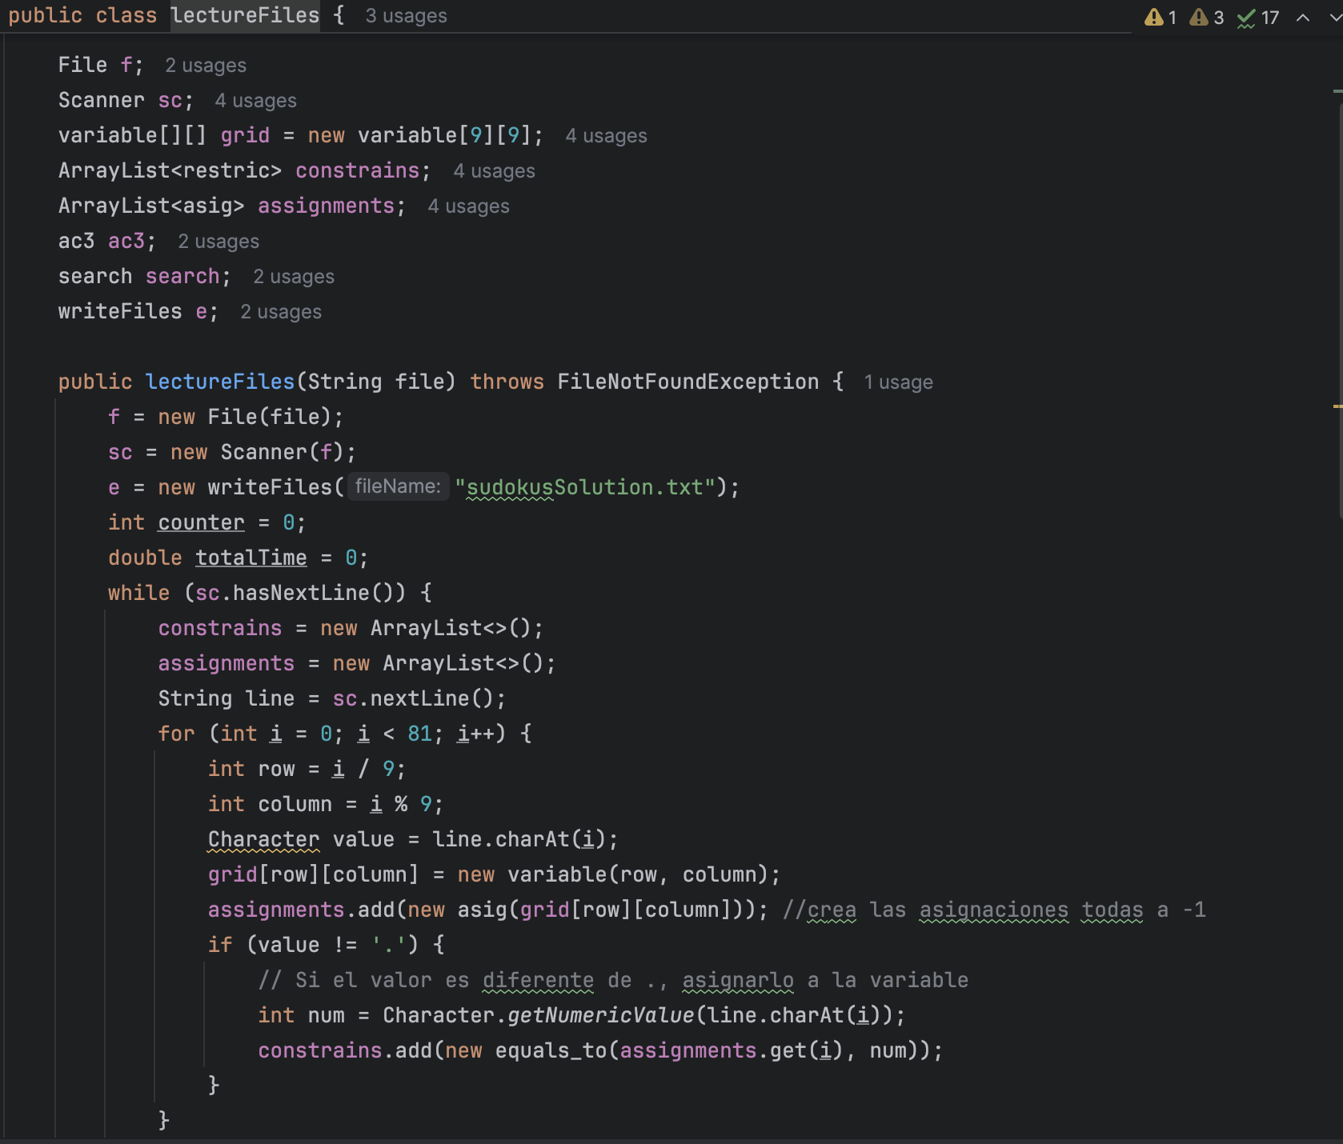
Snippet of the code:

Slide 24
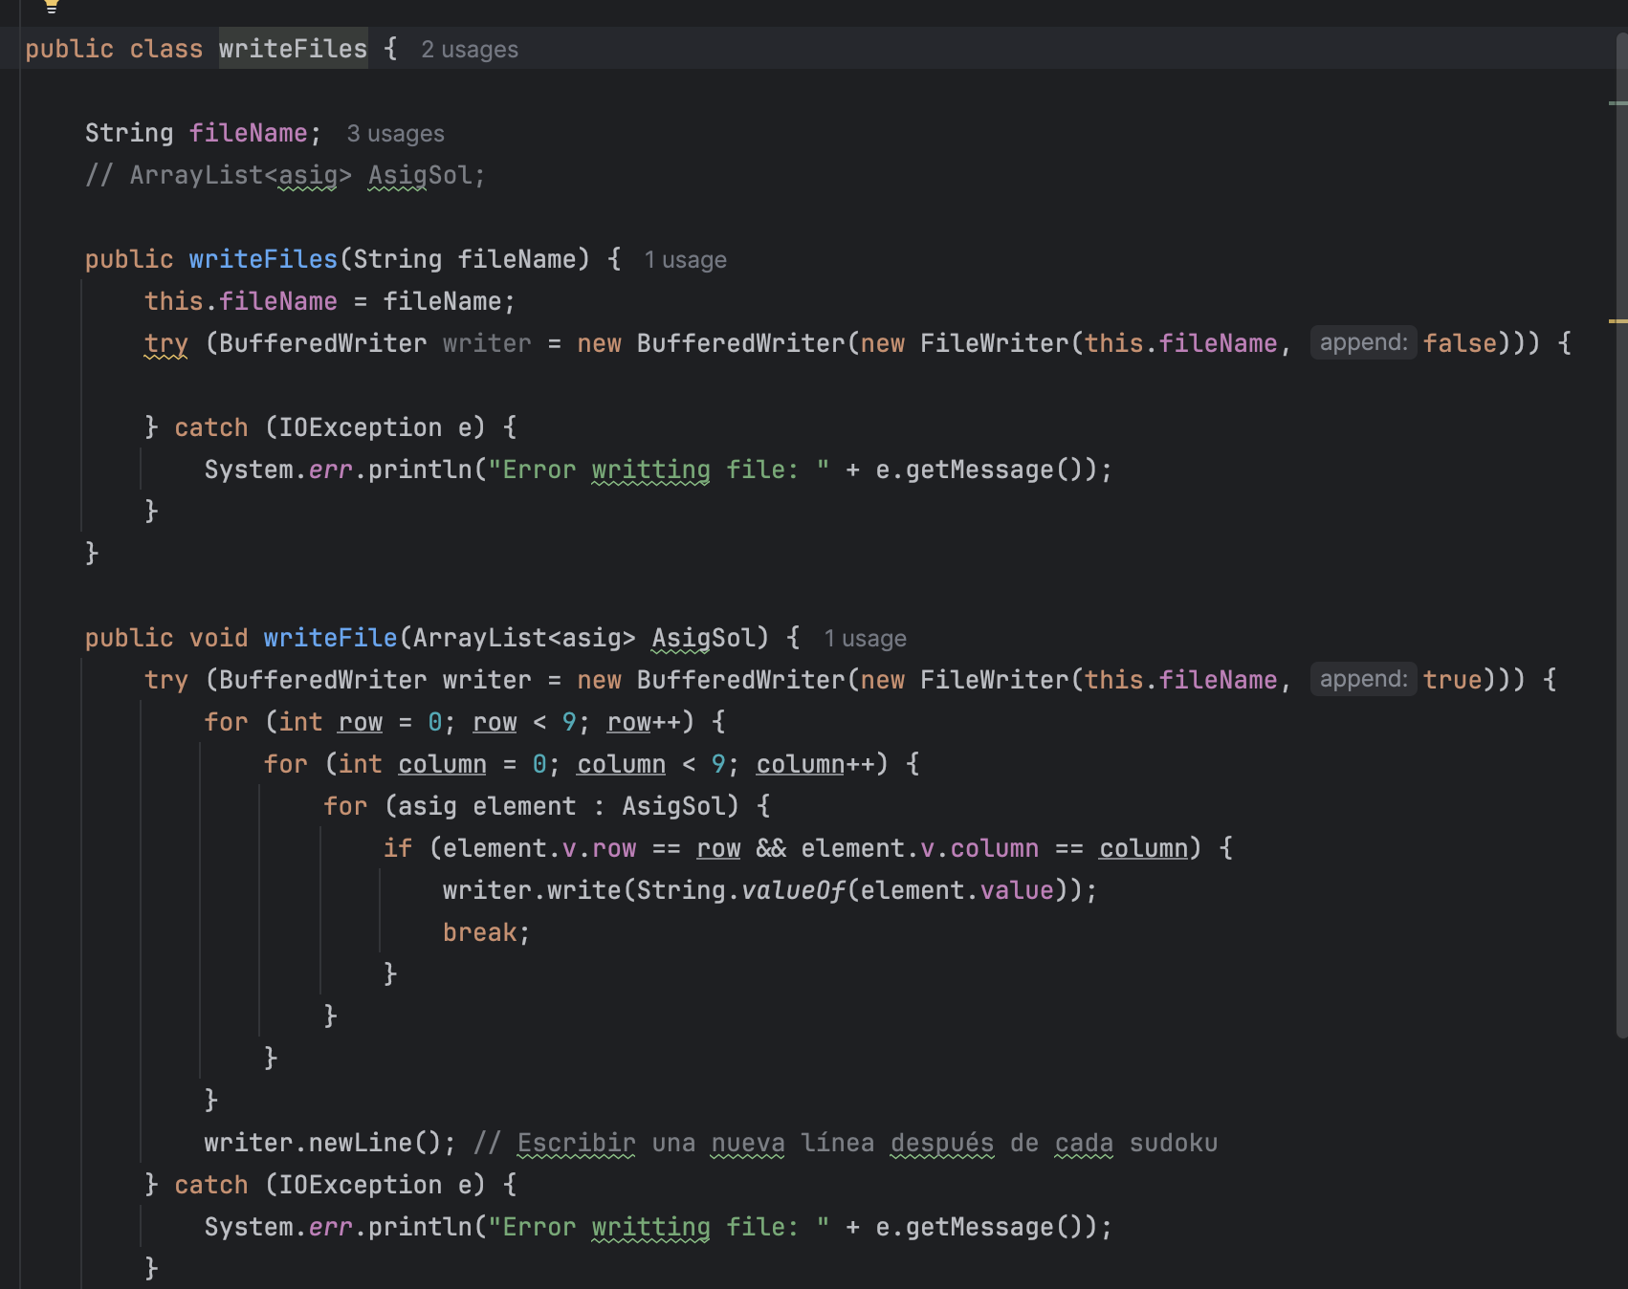
Files
Writefiles.java
Ensures the output file is ready for writing.
Formats and appends solutions to the file without overwriting existing data.

Slide 25
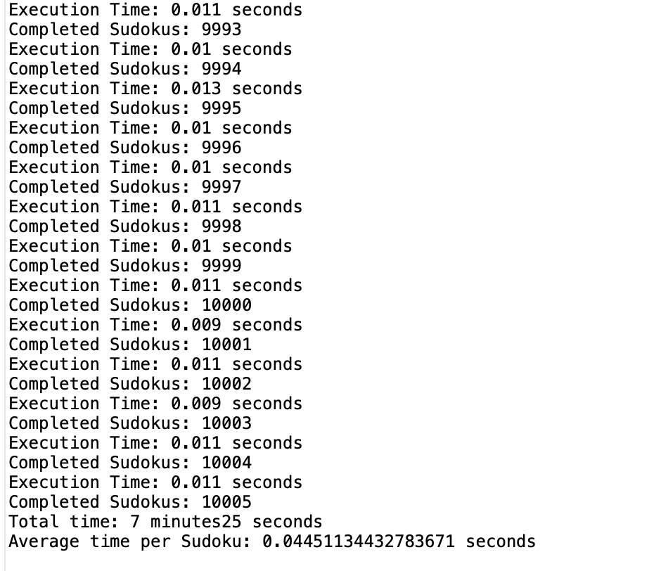

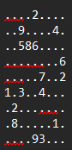
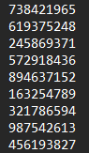
RESULTS
The program is able to complete sudokus in a minimal amount of time, including difficult sudokus.
Our goal is completed ✅
We tested it with 10.005 sudokus and the total time for doing it was 7min and the average time per sudoku was 0.0445 sec.
original
sudoku
sudoku
solution

Slide 26
Research
Our project builds on foundational studies and methodologies in Constraint Satisfaction Problems (CSPs), focusing on Sudoku resolution.
Foundational Algorithms:
Backtracking and Forward Checking: Used for initial implementations, where backtracking assigned values systematically, and forward checking proactively pruned domains, improving efficiency​
AC-3 Algorithm: Incorporated later to ensure arc consistency, significantly reducing variable domains and conflicts during the solving process

Slide 27
Research
Step-by-Step Development:
Starting with Simple Sudokus: Initial versions of the code focused on solving basic Sudoku puzzles with minimal constraints. These puzzles served as a testing ground to ensure the implementation of backtracking and forward checking worked as expected.
Incorporating Constraint Prioritization: After verifying the basic algorithm, we added prioritization to address the most constrained cells first (i.e., those with the fewest possible values). This modification improved the efficiency of solving moderately complex puzzles.
Handling Complex Sudokus: To solve puzzles with higher difficulty, we integrated the AC-3 algorithm. This step helped ensure arc consistency by systematically narrowing variable domains, reducing potential conflicts before backtracking.
Testing with a Variety of Puzzles: We expanded testing to include Sudokus of varying difficulty, ranging from beginner-level to expert-level. The code was iteratively refined to handle edge cases, such as puzzles with very few initial clues.
Optimizing Execution Time:After achieving functional accuracy, we focused on reducing the computational time. Techniques like minimizing redundant constraint checks and optimizing data structures for variable and constraint handling were applied.
Finalizing the Code: The final implementation was robust enough to solve over 10,000 puzzles efficiently, with an average solving time of 0.0445 seconds per puzzle.

Slide 28
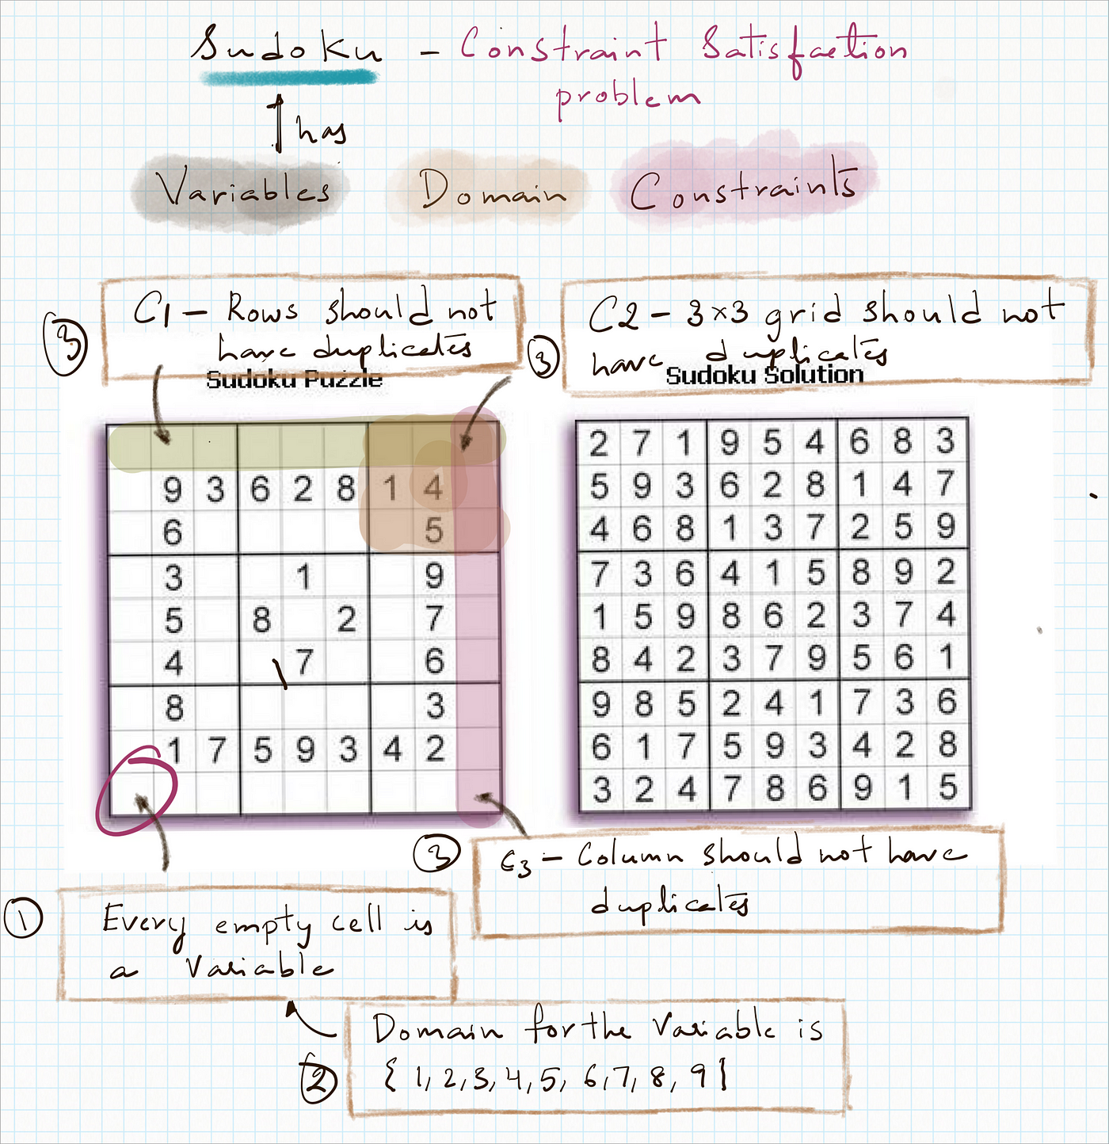
Research
Iterative Problem Solving:
Throughout development, we used a “trial and error” approach. Each modification was tested against both simple and complex Sudokus to ensure improvements did not introduce new issues.
This step-by-step process of iterative refinement and testing ensured that the final solution was both efficient and scalable!

Slide 29

Future Development
Explore advanced algorithms (e.g., machine learning integration).
Machine Learning Integration: By training machine learning models on solved CSP instances, the system could predict variable assignments or constraint prioritizations, reducing computational overhead and improving scalability.

Slide 30
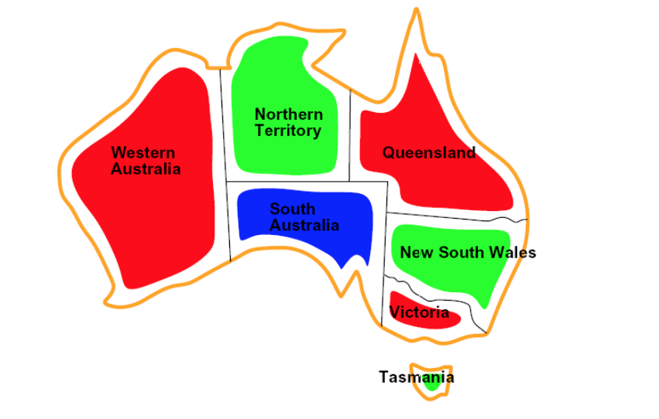
Future Development
Generalize the approach for a broader range of CSPs:
Beyond Sudoku, this program can be adapted for other optimization problems. Incorporating domain-specific constraints and scalability enhancements would make the system applicable across various industries.

Slide 31
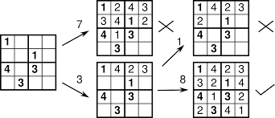
Conclusions
Through this project, we achieved significant milestones in applying CSP algorithms to Sudoku solving. Key outcomes include:
Algorithm Efficiency:
Over 10,000 puzzles were solved with an average time of 0.0445 seconds per puzzle.
Validation of the AC-3 and Backtracking with Forward Checking approaches in real-world applications.

Slide 32
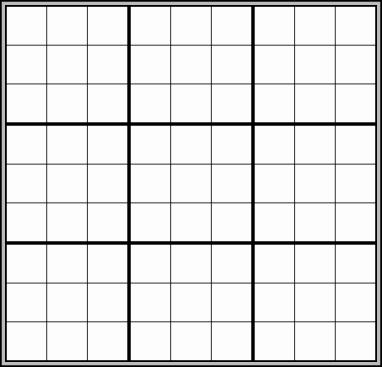
Conclusions
Handling Special Cases:
Empty Sudoku Grids: The program successfully resolves completely empty Sudoku puzzles as it can freely assign values while respecting all constraints, takes advantage of the full flexibility of the CSP framework.
Unsolvable Puzzles: When the program encounters a Sudoku puzzle with no solution, it eventually stops after trying all possibilities, as the constraints lead to dead ends. This reveals a limitation in detecting and managing unsolvable cases effectively.

Slide 33
THANK YOU!

